Slide 1
J2EE

Slide 2
Overview
Stands for “Java 2, Enterprise Edition”
It is a collection of standards
  JDBC, JNDI, JMX, JMS
It is a component technology
  Enterprise JavaBeans
It is an “application server”
  Following in the footsteps of Component Transaction Monitors

Slide 3
Why J2EE
Developers want to write distributed transactional applications for the enterprise
Application should be secure & reliable , cost effective, fast to develop
To reduce costs and fast-track application design and development, the Java™2 introduce a platform, Enterprise Edition (J2EE™)
J2EE provides a component-based approach to the design, development, assembly, and deployment of enterprise applications.

Slide 4
J2EE Offered
Multi-tiered distributed application model
Reusable components
A unified security model
flexible transaction control
Web services support through integrated data interchange on Extensible Markup Language (XML)-based open standards and protocols.

Slide 5
J2EE Architecture
The J2EE platform uses a distributed multi-tiered application model for enterprise applications.
J2EE is a four-tier architecture :
Client-tier components run on the client machine.
Web-tier components run on the J2EE server.
Business-tier components run on the J2EE server.
Enterprise information system (EIS)-tier software runs on the EIS server.

Slide 6
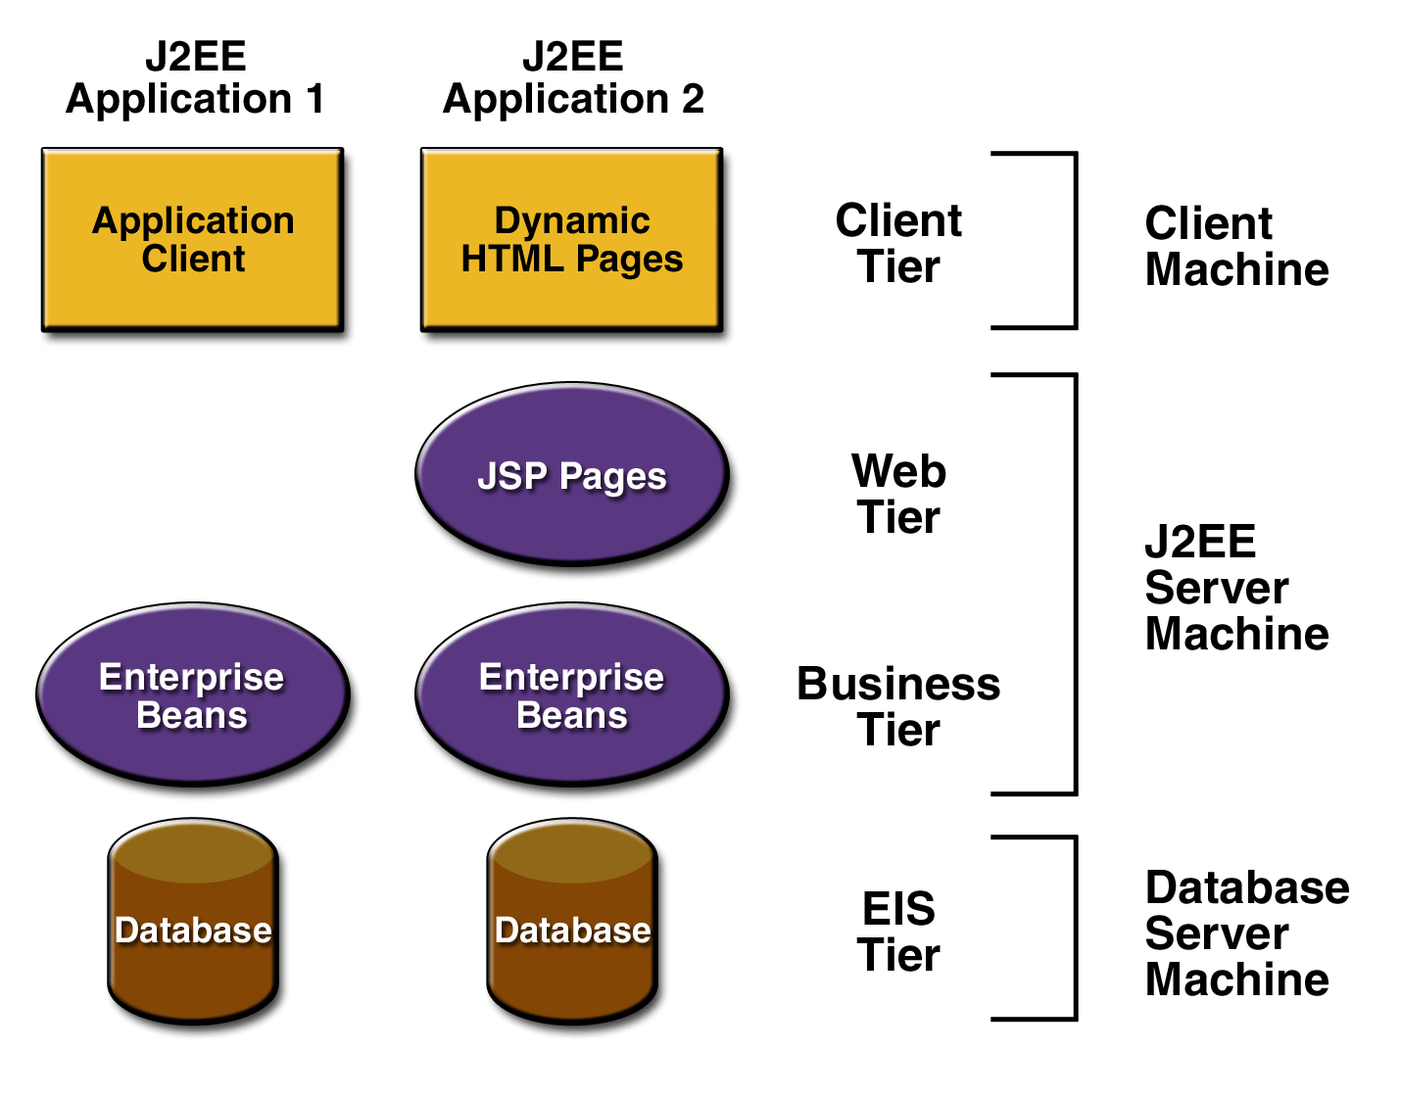
J2EE Architecture
Each tier is focused on providing a specific type of functionality to an application.
Two or more tiers can physically reside on the same Java Virtual Machine (JVM) although each tier provides a different type of functionality to a J2EE application.
J2EE multi-tier architecture is functionally centric, a J2EE application accesses only tiers whose functionality is required by the J2EE application.

Slide 7
J2EE Architecture Communication
Client Tier
Client program to interact with user Convert input data into request & forward to next tier
Client program transfer reply in to text & screen for user
Reply
Client Request
Use HTTP
Web Tier
The Web Tier provides Internet functionality to a J2EE application. Use HTTP for response & request
Request (RMI)
Reply
The Enterprise JavaBeans Tier contains the business logic for J2EE applications. Requests are made by using the Java Remote Method Invocation (RMI) API.
Manages transactions and security, and assures that multithreading and persistence are properly
implemented
Business Tier (EJB)
Reply
Request
EIS Tier is the J2EE architecture’s connectivity to resources that are not part of J2EE, such as legacy systems, DBMS, and systems provided by third parties that are accessible to components in the J2EE infrastructure.
Enterprise information system (EIS)-tier

Slide 8
J2EE Architecture Communication
Access Control List (ACL):-
Access is made using an Access Control List (ACL) that controls communication between tiers. The ACL is a critical design element in the J2EE multi-tier architecture because ACL bridges tiers that are typically located on different virtual local area networks and because ACL adds a security level to web applications. Hackers typically focus their attack on the Web Tier to try to directly access DBMS. ACL prevents direct access to DBMS and similar resources.

Slide 9
Client Tier Implementation
There are two components on the Client Tier that are described in the J2EE specification. These are applet clients and application clients.
An applet client is a component used by a web client that operates within the applet container, which is a Java-enabled browser. An applet uses the browser as a user interface. An applet uses the browser as a user interface.
An application client is a Java application that operates within the application client container, which is the Java 2 Runtime Environment, Standard Edition (JRE). An application has its own user interface and is capable of accessing all the tiers in the multi-tier architecture depending how the ACLs are configured, although typically an application has access to only the web layer.

Slide 10
Client Tier Implementation
Besides defining clients as an applet client, application client, clients are also classified by the technology used to access components and resources that are associated with each tier.
There are five classifications: a web client, Enterprise JavaBeans client, Enterprise Information System (EIS) client, web service peers, and a multi-tier client.
Web Client:- usually a browser, that accesses resources located on the Web Tier. These resources typically consist of web pages written in HTML or XML. Web clients communicate with Web Tier resources using either HTTP or the Hypertext Transmission Protocol Secured (HTTPS), which is used to transfer encrypted information.

Slide 11
Client Tier Implementation
Enterprise JavaBeans clients:- only accesses one or more Enterprise JavaBeans that are located on the Enterprise JavaBeans Tier rather than resources on the Web Tier. This access is made possible by using the RMI API. RMI handles communication between the Enterprise JavaBeans client and the Enterprise JavaBeans Tier using either the Java Remote Method Protocol (JRMP) or the Internet Inter-ORB Protocol (IIOP).
EIS clients:-EIS clients are the interface between users and resources located on the EIS Tier. These clients use Java connectors, appropriate APIs, or proprietary protocols to utilize resources such as DBMS and legacy data sources.

Slide 12
Client Tier Implementation
A web service peer :- A web service peer is a unique type of client because it’s also a service that works on the Web Tier. Technically, a web service peer forms a peer-to-peer relationship with other components on the Web Tier rather than a true client/server relationship. a web service peer makes requests over HTTP using either electronic business XML or the Simple Object Access Protocol (SOAP)
Multi-tier clients :- It accesses components located on tiers other than the tier where the multitier client resides. Multi-tier clients typically use the Java Message Service (JMS) to communicate asynchronously with other tiers.

Slide 13
Web Tier Implementation
The Web Tier has several responsibilities in the J2EE multi-tier architecture, all of which is provided to the Client Tier using HTTP.
Act as an intermediary between components on web tier & other tier
Intermediary activities include:
Accepting requests from other software that was sent using POST, GET, and PUT operations, which are part of HTTP transmissions
Transmit data such as images and dynamic content
There are two types of components that work on the Web Tier. These are servlets and Java Server Pages (JSP)

Slide 14
Enterprise JavaBeans Tier Implementation
The Enterprise JavaBeans Tier contains the Enterprise JavaBeans server, which is the object server that stores and manages Enterprise JavaBeans.
This tier provides concurrency, scalability, lifecycle management, and fault tolerance.
The Enterprise JavaBeans server and Enterprise JavaBeans container are responsible for low-level system services that are required to implement business logic of an Enterprise Java Bean. These system services are:
Resource pooling , Distributed object protocols, Thread management, State management, Process management, Object persistence, Security, Deploy-time configuration
Components on the Client Tier and the Web Tier communicate with the Enterprise JavaBeans Tier using the Java RMI API and either IIOP or JRMP.

Slide 15
Enterprise Information Systems Tier
Implementation
The Enterprise Information Systems (EIS) Tier is the J2EE architecture’s connectivity to resources that are not part of J2EE.
This tier provides flexibility to developers of J2EE applications because developers can leverage existing systems and resources currently available to the corporation and do not need to replicate them in J2EE.
EIS Tier provides the connectivity between a J2EE
application and non-J2EE software. This connectivity is made possible through the use of CORBA and Java Connectors or through proprietary protocols.

Slide 16
J2EE Technologies
Java Servlets
JSP (Java Server Pages)
EJB (Enterprise Java Beans)
JMS (Java Message Service)
JDBC (Database API)
JNDI (Java Naming & Directory Interface)
JTA / JTS (Java Transaction API /Service)
JavaMail
JAAS (Java Authentication & Authorization Service)
XML

Slide 17
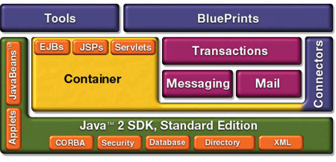
J2EE Components

Slide 18
J2EE Containers
Containers are the interface between a component and the low-level platform-specific functionality that supports the component.
Before a web component, enterprise bean, or application client component can be executed, it must be assembled into a J2EE module and deployed into its container.
J2EE support configuration of container setting for following services:-

Slide 19
J2EE Containers
The J2EE security model lets you configure a web component or enterprise bean so that system resources are accessed only by authorized users.
The J2EE transaction model lets you specify relationships among methods that make up a single transaction so that all methods in one transaction are treated as a single unit.
JNDI lookup services provide a unified interface to multiple naming and directory services in the enterprise so that application components can access naming and directory services.
The J2EE remote connectivity model manages low-level communications between clients and enterprise beans. After an enterprise bean is created, a client invokes methods on it as if it were in the same virtual machine.
The container also manages no configurable services such as enterprise bean and servlet life cycles, database connection resource pooling, data persistence.

Slide 20
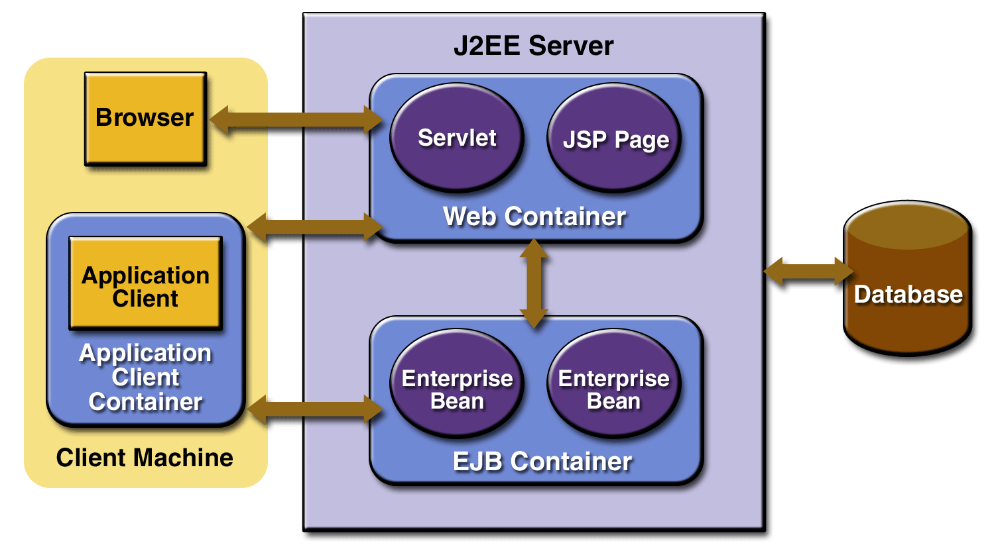
Container Types
Figure J2EE Server and Containers

Slide 21
Container Types
J2EE server:-
The runtime portion of a J2EE product. A J2EE server provides EJB and web containers.
Enterprise JavaBeans (EJB) container
Manages the execution of enterprise beans for J2EE applications. Enterprise beans and their container run on the J2EE server.
Web container
Manages the execution of JSP page and servlet components for J2EE applications. Web components and their container run on the J2EE server.
Application client container
Manages the execution of application client components. Application clients and their container run on the client.
Applet container
Manages the execution of applets. Consists of a web browser and Java Plug-in running on the client together.

Slide 22
Web Services Support
Web services are web-based enterprise applications that use open, XML-based standards and transport protocols to exchange data with calling clients
XML:- XML is a cross-platform, extensible, text-based standard for representing data. When XML data is exchanged between parties, the parties are free to create their own tags to describe the data, set up schemas to specify which tags can be used in a particular kind of XML document, and use XML stylesheets to manage the display and handling of the data.

Slide 23
Web Services Support
SOAP Transport Protocol:- Client requests and web service responses are transmitted as Simple Object Access Protocol (SOAP) messages over HTTP to enable a completely interoperable exchange between clients and web services, all running on different platforms and at various locations on the Internet.
The SOAP portion of a transported message handles the following:
Defines an XML-based envelope to describe what is in the message and how to process the message
Includes XML-based encoding rules to express instances of application defined data types within the message
Defines an XML-based convention for representing the request to the remote service and the resulting response

Slide 24
SOAP Elements
Envelope (mandatory)
  Top element of the XML document representing the message
Header (optional)
  Determines how a recipient of a SOAP message should process the message
  Adds features to the SOAP message such as authentication, transaction management, payment, message routes, etc…
Body (mandatory)
  Exchanges information intended for the recipient of the message.
  Typical use is for RPC calls and error reporting.

Slide 25
Simple Example
<Envelope>
<Header>
<transId>345</transId>
</Header>
<Body>
<Add>
<n1>3</n1>
<n2>4</n2>
</Add>
</Body>
</Envelope>
c = Add(n1, n2)

Slide 26
Web Services Description Language
WSDL is an XML language that contains information about the interface semantics and ‘administrivia’ of a call to a Web Service
Once you develop a Web Service you publish its description and a link to it in a UDDI repository so that potential users can find it
When someone wants to use your service, they request the WSDL file in order to find out the location of the service, the function calls and how to access them
Then they use this information in your WSDL file to form a SOAP request to the computer

Slide 27
Web Services Description Language
Definitions:
- WSDL is an XML-based language used to define Web Services and describe how to access them.
- WSLD is an XML format for describing network services as a set of endpoints operating on messages containing either document-oriented or procedure-oriented information.

Slide 28
Universal Description,
Discovery and Integration (UDDI)
Universal Description, Discovery and Integration is a SOAP application which attempts to standardize:
- How the availability of Web (and other) services is published
- How Web (and other) services can be (dynamically) discovered
UDDI permits business to register information about themselves and their services in UDDI Registries

Slide 29
Universal Description,
Discovery and Integration (UDDI)
The information held in UDDI Registries includes:
– Who offers services i.e. A business/organisation
– What services are offered i.e. “Book Hotel Room”
– Where the service can be found i.e.
A URL/endpoint
– How the services can be accessed i.e. SOAP/CORBA
UDDI enables web service clients to discover potential services
UDDI also enables businesses to discover
– Potential business partners
– Potential services to make use of

Slide 30
Packaging Applications
A J2EE application is delivered in an Enterprise Archive (EAR) file, a standard Java Archive (JAR) file with an .ear extension. Using EAR files and modules makes it possible to assemble a number of different J2EE applications using some of the same components. No extra coding is needed; it is only a matter of assembling (or packaging) various J2EE modules into J2EE EAR files.

Slide 31
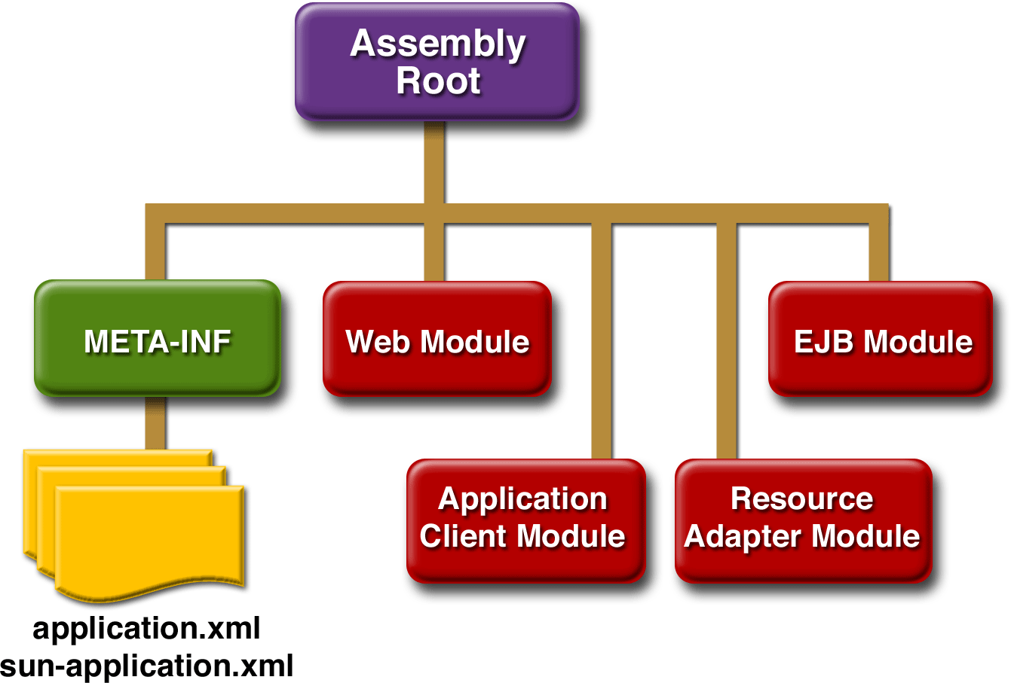
Packaging Applications
An EAR file contains J2EE modules and deployment descriptors. A deployment descriptor is an XML document with an .xml extension that describes the deployment settings of an application, a module, or a component. Because deployment descriptor information is declarative, it can be changed without the need to modify the source code. At runtime, the J2EE server reads the deployment descriptor and acts upon the application, module, or component accordingly.

